Slide 1

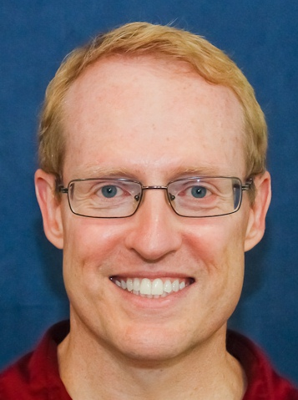

Course Overview: Part 1
Douglas C. Schmidt
d.schmidt@vanderbilt.edu
www.dre.vanderbilt.edu/~schmidt
Professor of Computer Science
Institute for Software Integrated Systems Vanderbilt University Nashville, Tennessee, USA

Slide 2
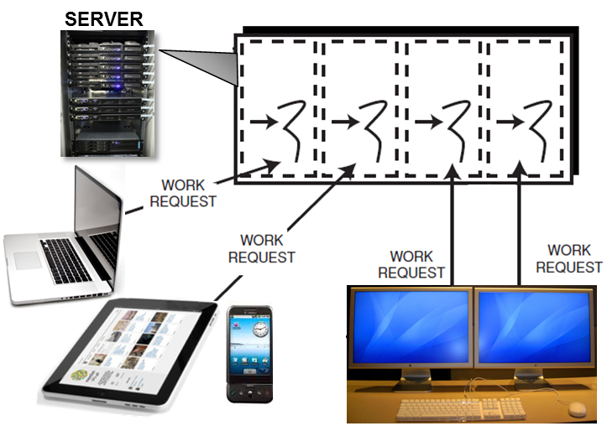
Topics Covered in this Part of the Module
Explore the motivations for & challenges of concurrent & networked software
Concurrent software can simultaneously run multiple computations that potentially interact with each other

Slide 3
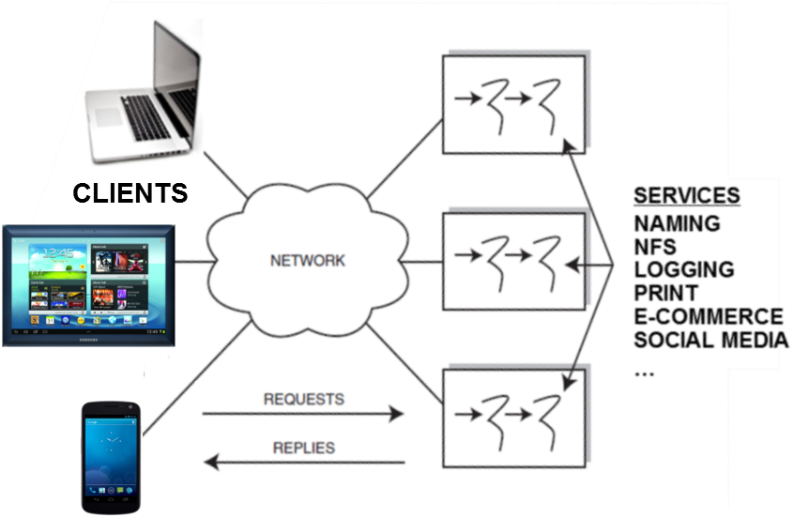
Topics Covered in this Part of the Module
Explore the motivations for & challenges of concurrent & networked software
Concurrent software can simultaneously run multiple computations that potentially interact with each other
Networked software defines protocols that enable computing devices to exchange messages & perform services remotely

Slide 4
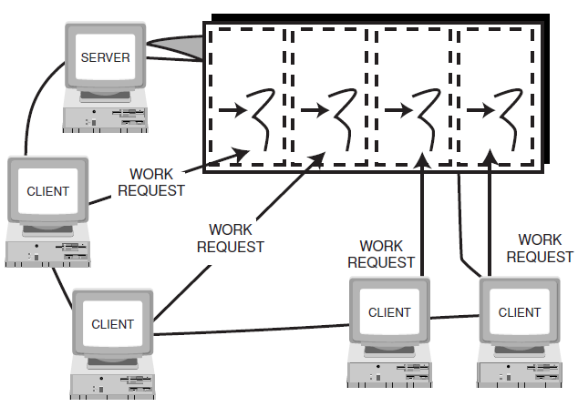
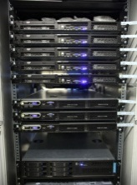







Motivations for Concurrent Software
Leverage hardware/software advances
e.g., multi-core processors & multi-threaded operating systems
SERVER
Notes:
http://commons.wikimedia.org/wiki/File:Hourglass_2.svg

Slide 5
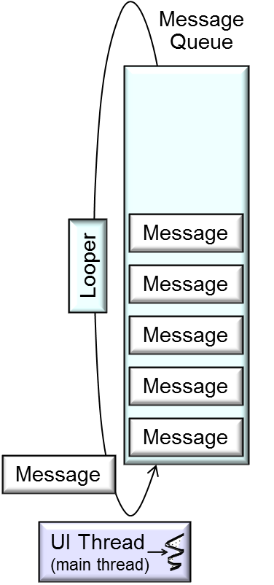
Motivations for Concurrent Software
Leverage hardware/software advances
Simplify program structure
e.g., by allow blocking operations
SERVER
Notes:
http://commons.wikimedia.org/wiki/File:Hourglass_2.svg

Slide 6
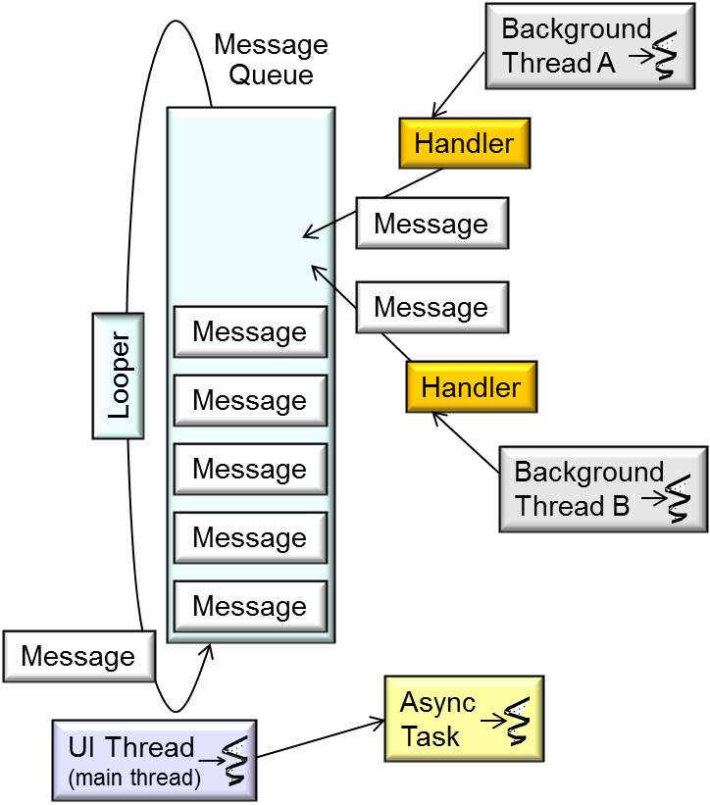
Motivations for Concurrent Software
Leverage hardware/software advances
Simplify program structure
e.g., by allow blocking operations
SERVER
Notes:
http://commons.wikimedia.org/wiki/File:Hourglass_2.svg

Slide 7
Motivations for Concurrent Software
Leverage hardware/software advances
Simplify program structure
e.g., by allow blocking operations
SERVER
private Bitmap bitmap;
final ImageView iview = ...
final Button button = ...
button.setOnClickListener (new OnClickListener() {
public void onClick(View v) { new Thread(
new Runnable() {
public void run() {
bitmap = downloadImage(URI);
iview.post(new Runnable() {
public void run() { iview.setImageBitmap(bitmap);}
});
}
}).start();
Handles button clicks
Download an image
Display bitmap in the UI thread
Start a new thread
Notes:
http://commons.wikimedia.org/wiki/File:Hourglass_2.svg

Slide 8
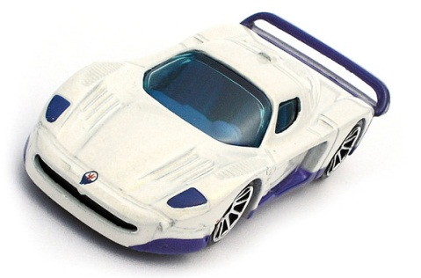
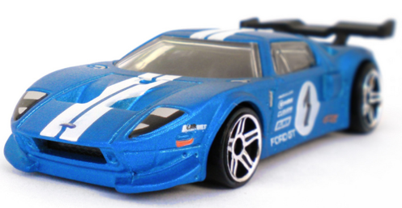
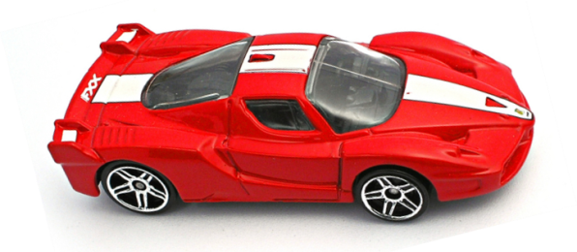
Motivations for Concurrent Software
Leverage hardware/software advances
Simplify program structure
Increase performance
Parallelize computations & communications
SERVER
Notes:
http://www.flickr.com/photos/10581663@N08/4456764158/, http://www.flickr.com/photos/10581663@N08/3238312647/

Slide 9

Motivations for Concurrent Software
Leverage hardware/software advances
Simplify program structure
Increase performance
Improve response-time
e.g., don’t starve the UI thread
SERVER
Notes:
http://commons.wikimedia.org/wiki/File:Hourglass_2.svg

Slide 10

Challenges for Concurrent Software
Accidental Complexities
Stem from limitations with development tools & techniques
Notes:
http://www.flickr.com/photos/26170836@N05/3916863285/

Slide 11
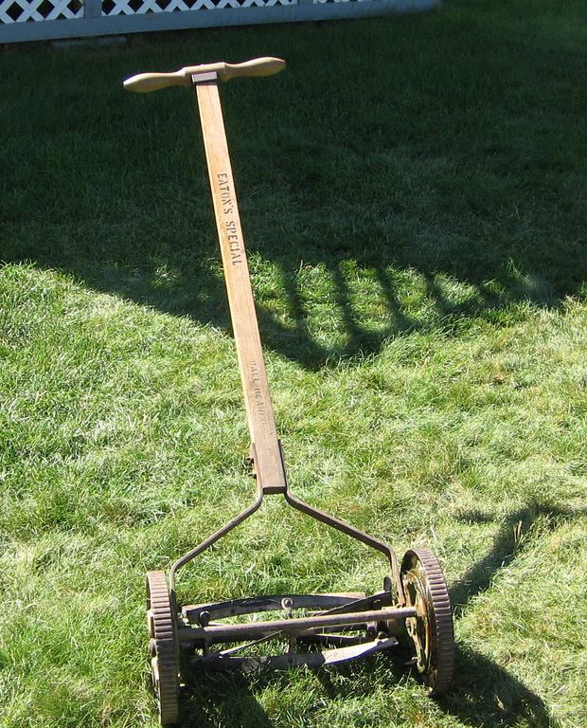

Challenges for Concurrent Software
Accidental Complexities
Low-level APIs
Tedious, error-prone, & non-portable
Notes:
http://www.flickr.com/photos/26170836@N05/3916863285/

Slide 12
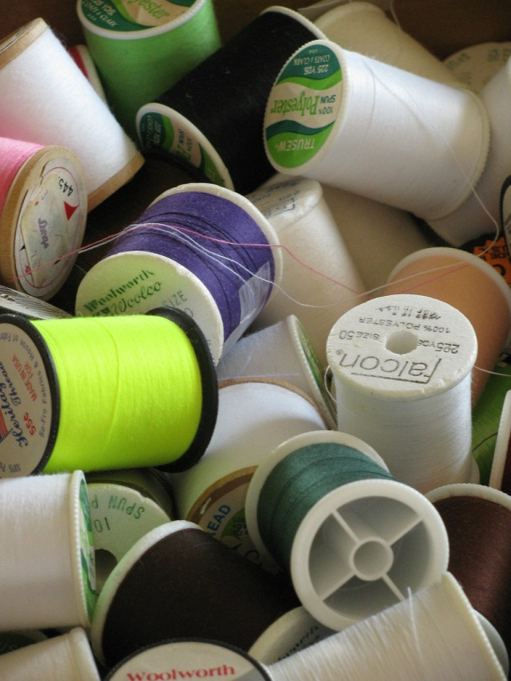
Challenges for Concurrent Software
Accidental Complexities
Low-level APIs
typedef struct { char message_[20]; int thread_id_; } PARAMS;
void *print_hello_world (void *ptr) {
PARAMS *params = (PARAMS *) ptr;
printf ("%s from thread %d\n", params->message_, params->thread_id_);
}
int main (void) {
pthread_t thread; PARAMS params;
params.thread_id_ = 1; strcpy (params.message_, "Hello World");
pthread_create (&thread, 0, &print_hello_world, (void *) &params);
/* ... */
pthread_join(thread, 0);
return 0;
}
Cast from void *
Not portable to non-POSIX platforms
Pointer-to-function
Cast to void *
“Quasi-typed” thread handle
Notes:
http://www.flickr.com/photos/48380660@N04/4670622965/

Slide 13
Challenges for Concurrent Software
Accidental Complexities
Low-level APIs
typedef struct { char message_[20]; int thread_id_; } PARAMS;
void *print_hello_world (void *ptr) {
PARAMS *params = (PARAMS *) ptr;
printf ("%s from thread %d\n", params->message_, params->thread_id_);
}
int main (void) {
pthread_t thread; PARAMS params;
params.thread_id_ = 1; strcpy (params.message_, "Hello World");
pthread_create (&thread, 0, &print_hello_world, (void *) &params);
/* ... */
pthread_join(thread, 0);
return 0;
}
Other C threading APIs have similar accidental complexities
Notes:
http://www.flickr.com/photos/26170836@N05/3916863285/

Slide 14

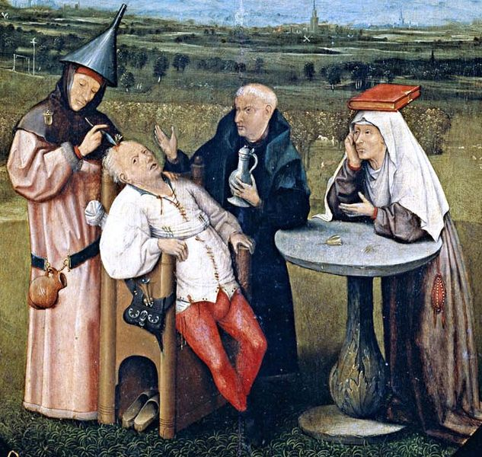
Challenges for Concurrent Software
Accidental Complexities
Low-level APIs
Limited debugging tools
Notes:
http://www.flickr.com/photos/37921614@N00/3312946500, http://en.wikipedia.org/wiki/File:Hieronymus_Bosch_053_detail.jpg

Slide 15
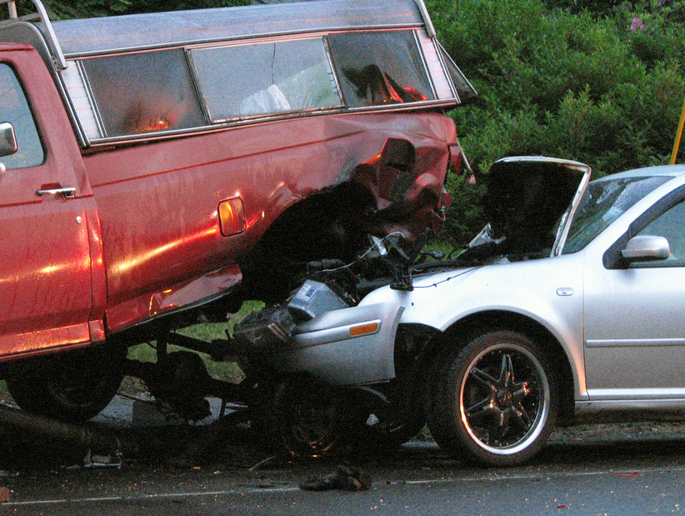
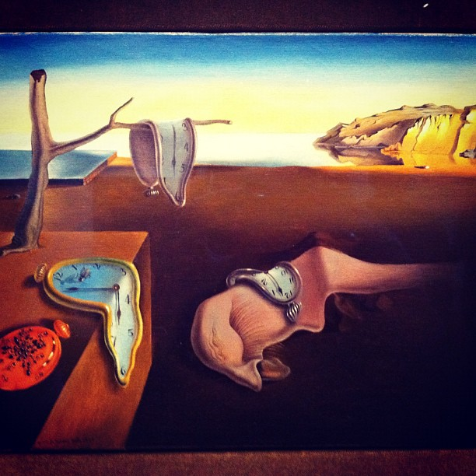
Challenges for Concurrent Software
Accidental Complexities
Low-level APIs
Limited debugging tools
See www.dre.vanderbilt.edu/~schmidt/PDF/DSIS.pdf & www.fluid.cs.cmu.edu
Notes:
http://www.flickr.com/photos/32496077@N03/6988551091/, http://www.flickr.com/photos/8241297@N03/2560143236/

Slide 16

Challenges for Concurrent Software
Accidental Complexities
Low-level APIs
Limited debugging tools
Inherent Complexities
Stem from fundamental domain challenges
Notes:
http://www.flickr.com/photos/40143737@N02/5185921517/

Slide 17


Challenges for Concurrent Software
Accidental Complexities
Low-level APIs
Limited debugging tools
Inherent Complexities
Synchronization
Scheduling
Notes:
http://www.flickr.com/photos/53370644@N06/4976497160/, http://www.flickr.com/photos/62776155@N02/7113254989/

Slide 18
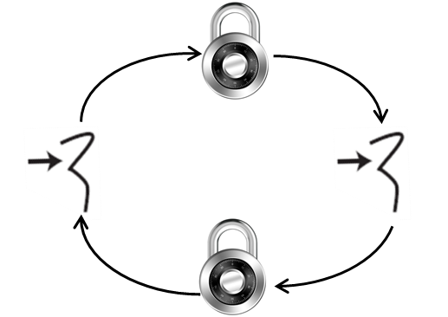


Challenges for Concurrent Software
Accidental Complexities
Low-level APIs
Limited debugging tools
Inherent Complexities
Synchronization
Scheduling
Deadlocks
<<needs>>
L₂
<<owns>>
T₁
T₂
L₁
<<owns>>
<<needs>>
See www.dre.vanderbilt.edu/~schmidt/PDF/BC-schmidt.pdf for more info
Notes:
http://www.flickr.com/photos/26170836@N05/3916863285/

Slide 19
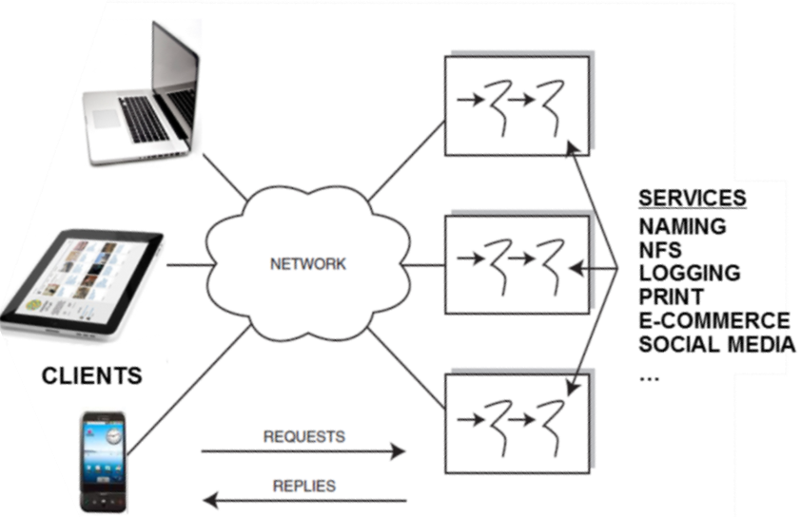
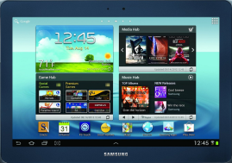


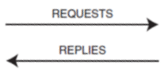

Motivations for Networked Software
Collaboration & commerce
e.g., file sharing, social media, e-commerce online transaction processing, B2B supply chain management, etc.
CLIENTS
Notes:
http://www.flickr.com/photos/25188498@N03/5341765493/

Slide 20
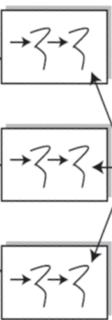






Motivations for Networked Software
Collaboration & commerce
Scalability
e.g., utility computing in clouds
CLIENTS
Notes:
http://www.flickr.com/photos/42623262@N03/3931165612/

Slide 21


Motivations for Networked Software
Collaboration & commerce
Scalability
Availability
e.g., minimizing single points of failure via replication
CLIENTS
Notes:
http://www.flickr.com/photos/44124479650@N01/5427262106, http://www.flickr.com/photos/17423713@N03/4791912041/

Slide 22


Motivations for Networked Software
Collaboration & commerce
Scalability
Availability
Cost effectiveness
e.g., via shared resources
CLIENTS
Notes:
http://www.flickr.com/photos/49946687@N05/5598849912, http://www.flickr.com/photos/88185917@N00/5570838704/

Slide 23
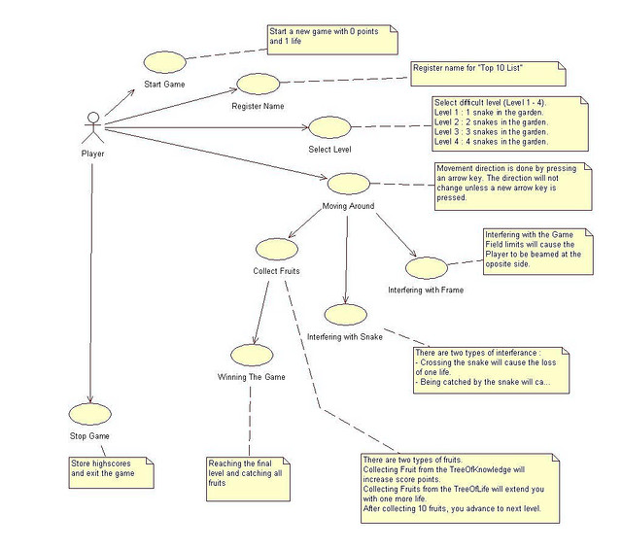
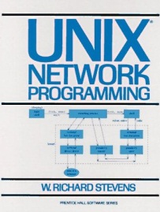
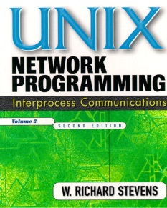
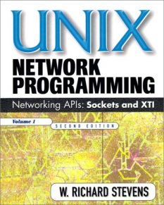
Challenges for Networked Software
Accidental Complexities
Algorithmic decomposition
Notes:
http://www.flickr.com/photos/66202740@N00/33625104/

Slide 24

Challenges for Networked Software
Accidental Complexities
Algorithmic decomposition
Continuous re-discovery & re-invention of core components
See steve.vinoski.net/pdf/IEEE-Middleware_Dark_Matter.pdf for more

Slide 25
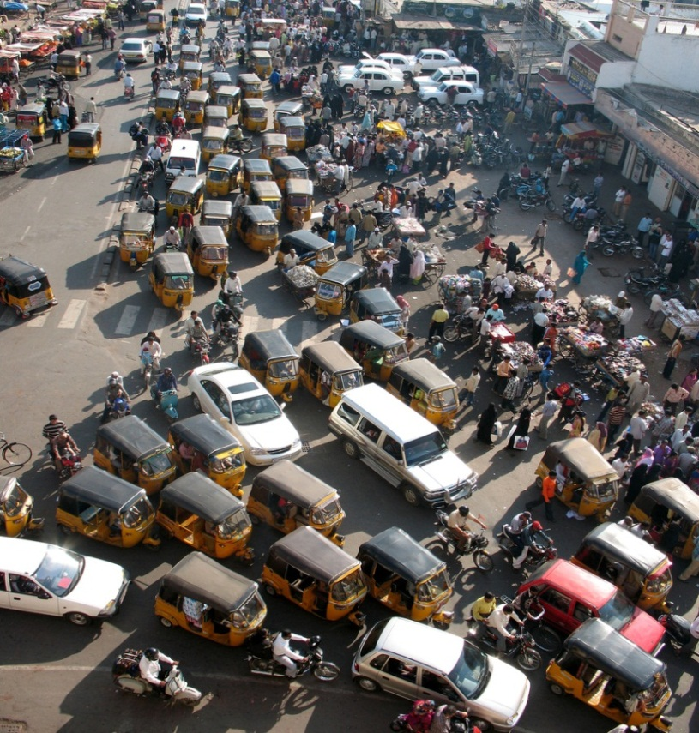

Challenges for Networked Software
Accidental Complexities
Algorithmic decomposition
Continuous re-discovery & re-invention of core components
Inherent Complexities
Latency & jitter
Notes:
http://en.wikipedia.org/wiki/File:A._gigantea_Aldabra_Giant_Tortoise.jpg

Slide 26
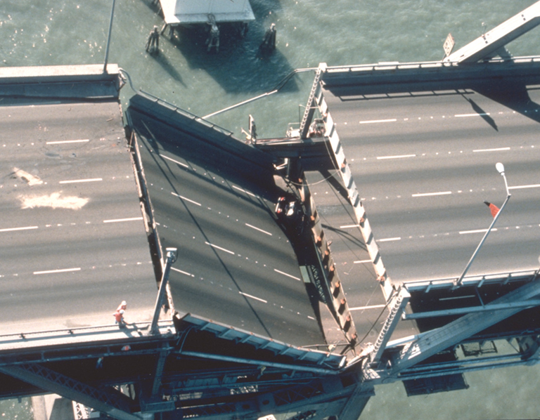
Challenges for Networked Software
Accidental Complexities
Algorithmic decomposition
Continuous re-discovery & re-invention of core components
Inherent Complexities
Latency & jitter
Reliability & partial failure
Notes:
http://www.flickr.com/photos/50514859@N00/220645446/

Slide 27


Challenges for Networked Software
Accidental Complexities
Algorithmic decomposition
Continuous re-discovery & re-invention of core components
Inherent Complexities
Latency & jitter
Reliability & partial failure
Security
See www.dre.vanderbilt.edu/~schmidt/PDF/pdcp-editorial.pdf for more info
Notes:
http://www.flickr.com/photos/54450095@N05/7853146846/, http://www.flickr.com/photos/69537337@N02/6322546385/

Slide 28
Summary
Concurrent & networked software helps
Leverage advances in hardware & networking technology
Meet the quality & performance needs of apps & services

Slide 29

Summary
Concurrent & networked software helps
Leverage advances in hardware technology
Meet the quality & performance needs of apps & services
Successful concurrent & networked software solutions must address key accidental & inherent complexities arising from
Limitations with development tools/techniques
Fundamental domain challenges

Slide 30

Summary
Concurrent & networked software helps
Leverage advances in hardware technology
Meet the quality & performance needs of apps & services
Successful concurrent & networked software solutions must address key accidental & inherent complexities arising from
Limitations with development tools/techniques
Fundamental domain challenges
As concurrent & networked systems have grown in scale & functionality they must cope with a broader & more challenging set of complexities
Notes:
http://www.flickr.com/photos/10101046@N06/3484426248/

Slide 31
Course Overview: Part 2
Douglas C. Schmidt
d.schmidt@vanderbilt.edu
www.dre.vanderbilt.edu/~schmidt
Professor of Computer Science
Institute for Software Integrated Systems Vanderbilt University Nashville, Tennessee, USA

Slide 32
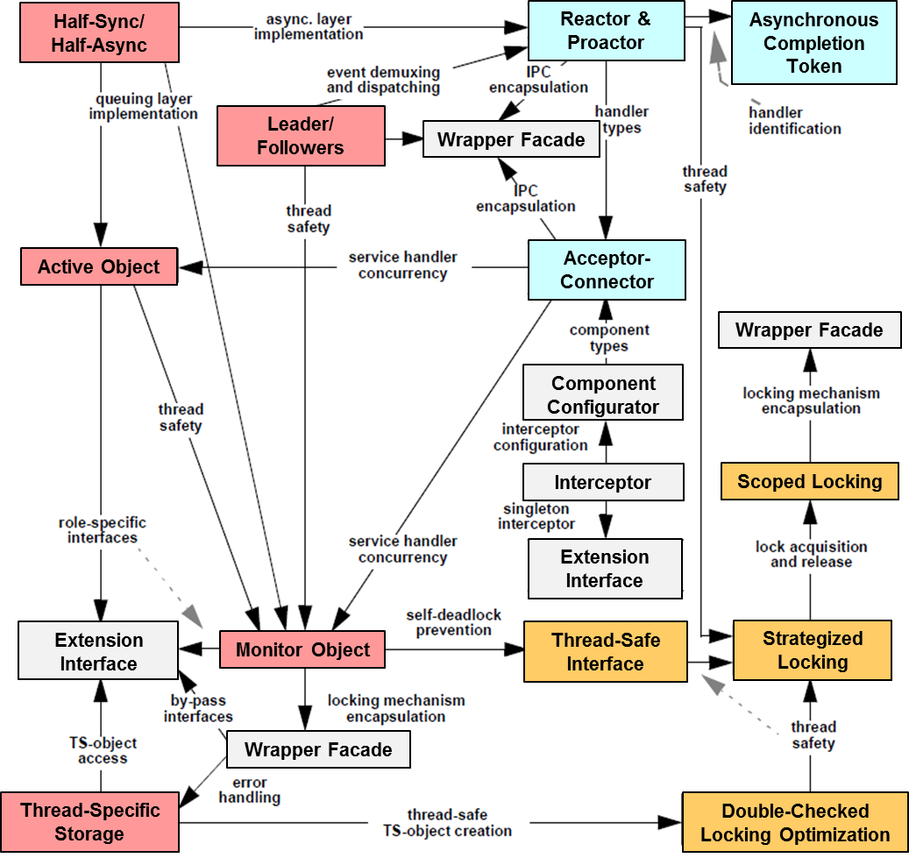
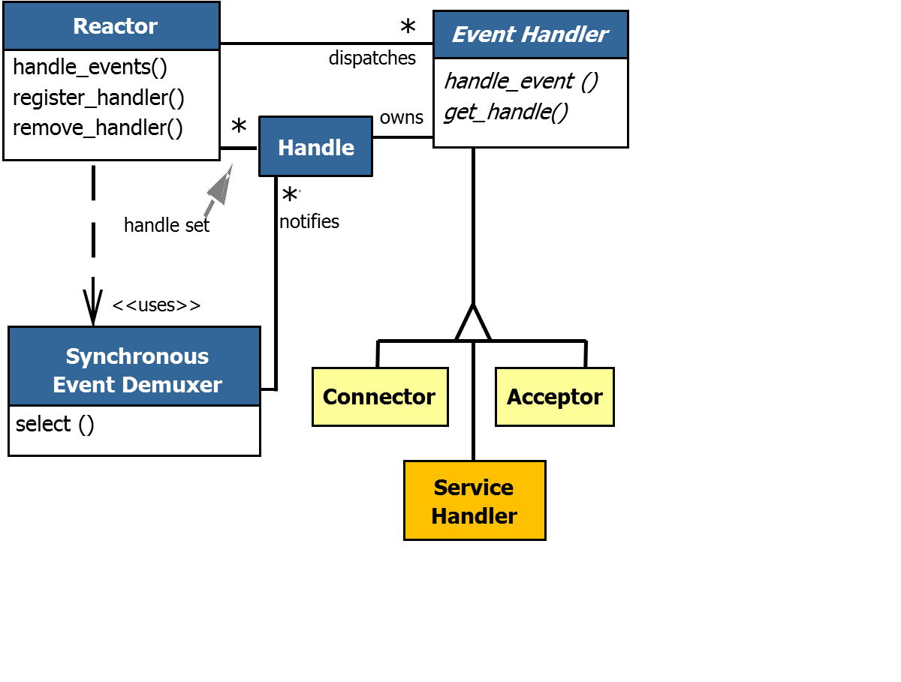
Topics Covered in this Part of the Module
Explore the motivations for & challenges of concurrent & networked software
Describe how patterns & frameworks help address challenges of concurrent & networked software
This section gives a high-level overview of patterns & frameworks

Slide 33
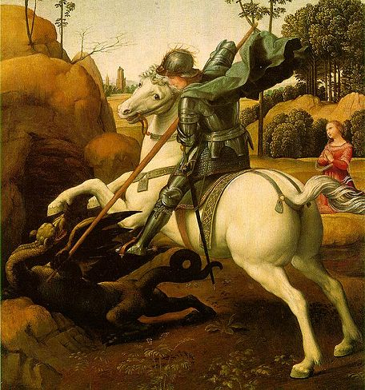
Motivation
To slay the dragons of accidental & inherent complexity associated with concurrent & networked software we need to codify proven software experience
Notes:
http://en.wikipedia.org/wiki/File:Saint_george_raphael.jpg

Slide 34
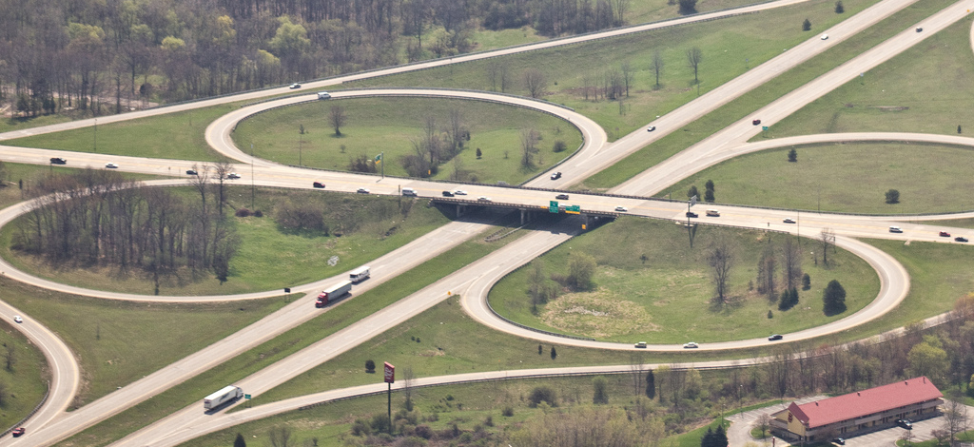
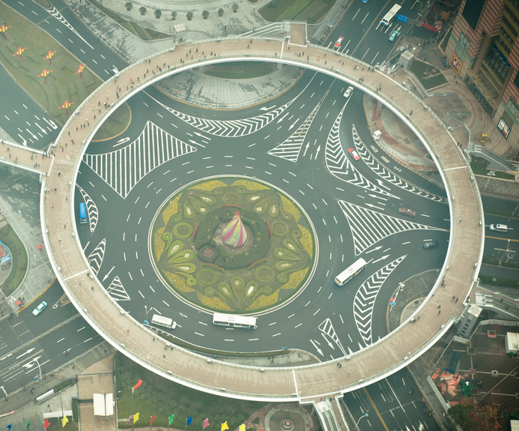
Part of the Solution: Patterns
Present solutions to common problems arising within a context
Notes:
http://www.fhwa.dot.gov/publications/research/safety/07032, http://www.flickr.com/photos/23090954@N03/6820932624/

Slide 35




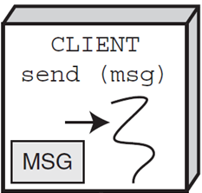
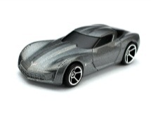
Part of the Solution: Patterns
Present solutions to common problems arising within a context
Electronic Trading
Aerospace
Mobile Devices
HTTP Client
GET /index.html HTTP/1.0
Automotive
<H1>DOC group page</H1>...
HTTP Server
Web Services
www.dre. vanderbilt.edu
Notes:
http://www.flickr.com/photos/50115004@N00/6941824942/

Slide 36
Part of the Solution: Patterns
Present solutions to common problems arising within a context
Help balance & resolve key software design forces
Predictability
Latency
Modularity
Reusability
Flexibility & Extensibility
…
Patterns
Notes:
http://www.flickr.com/photos/50115004@N00/6941824942/

Slide 37
Part of the Solution: Patterns
Present solutions to common problems arising within a context
Help balance & resolve key software design forces
Capture recurring structures & dynamics among software elements to facilitate reuse of successful designs
Subject
Observer
state
observerList
*
update
state = X;
notify();
setData
getData
notify
attach
detach
ConcreteObserver
Observer pattern
update
doSomething
for all observers in observerList do
observer.update()
s->getData()
Intent: “Define a one-to-many dependency between objects so that when one object changes state, all dependents are notified & updated”
Notes:
http://www.flickr.com/photos/50115004@N00/6941824942/

Slide 38


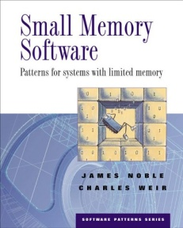

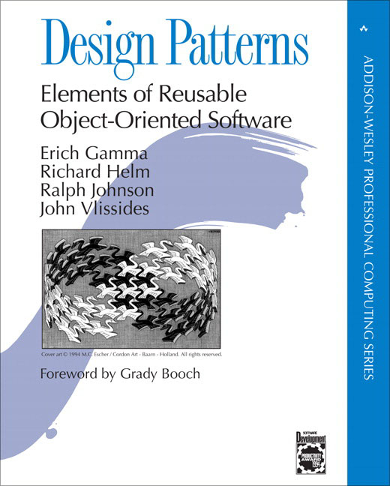
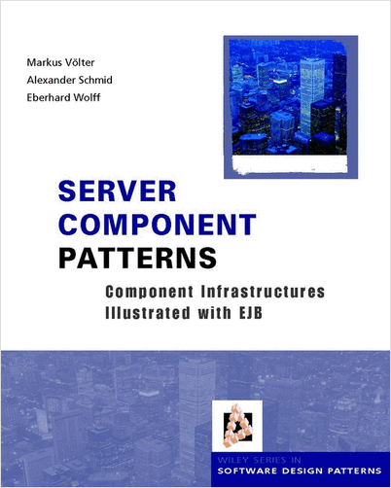
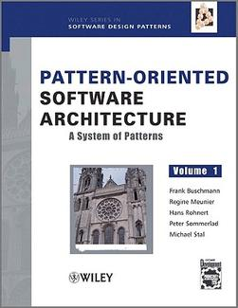
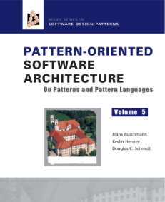

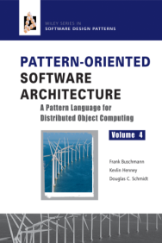

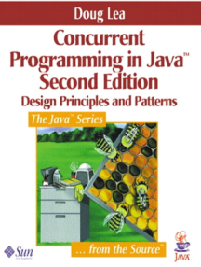
Part of the Solution: Patterns
Present solutions to common problems arising within a context
Help balance & resolve key software design forces
Capture recurring structures & dynamics among software elements to facilitate reuse of successful designs
Codify expert knowledge of design strategies, constraints & “best practices”
www.dre.vanderbilt.edu/~schmidt/CACM-patterns.html has more info
Notes:
http://www.flickr.com/photos/50115004@N00/6941824942/

Slide 39
Another Part of the Solution: Frameworks
Frameworks are integrated sets of software components that collaborate to provide reusable architectures for families of related applications

Slide 40

Another Part of the Solution: Frameworks
They exhibit “inversion of control” via callbacks
Application-specific functionality

Slide 41
Another Part of the Solution: Frameworks
They exhibit “inversion of control” via callbacks
They provide integrated domain- specific structures & functionality
Application-specific functionality
Electronic Trading
Mobile
Apps
Application domains
Social Media
Application domains
Application domains
Application domains
Networking
GUI
Infrastructure domains
Infrastructure domains
Infrastructure domains
Infrastructure domains
Database

Slide 42
Another Part of the Solution: Frameworks
They exhibit “inversion of control” via callbacks
They provide integrated domain- specific structures & functionality
They are “semi- complete” applications
Application-specific functionality
Electronic Trading
Mobile
Apps
Social Media
Hook methods
Networking
GUI
Hook
Database
Hook
Hook
Hook
Hook
www.dre.vanderbilt.edu/~schmidt/CACM-frameworks.html has more info

Slide 43
Key Benefit: Enable Systematic Software Reuse
Patterns & frameworks codify proven experience to enable
Design reuse – Match problems to relevant structures/dynamics & patterns in a domain
Problem | Pattern
Encapsulating low-level system functions to enhance portability | Wrapper Façade
Demuxing broker core events efficiently | Reactor
Managing broker connections efficiently | Acceptor- Connector
Enhancing broker scalability by processing requests concurrently | Half-Sync/ Half-Async
Efficiently synchronize the Half-Sync/Async request queue | Monitor Object
… | …
Defining the broker’s base-line architecture | Broker

Slide 44
Key Benefit: Enable Systematic Software Reuse
Patterns & frameworks codify proven experience to enable
Design reuse – Match problems to relevant structures/dynamics & patterns in a domain
Code reuse – Reify proven designs within particular development environments & domains
Problem | Pattern
Encapsulating low-level system functions to enhance portability | Wrapper Façade
Demuxing broker core events efficiently | Reactor
Managing broker connections efficiently | Acceptor- Connector
Enhancing broker scalability by processing requests concurrently | Half-Sync/ Half-Async
Efficiently synchronize the Half-Sync/Async request queue | Monitor Object
… | …
Defining the broker’s base-line architecture | Broker
Patterns & frameworks help avoid “reinventing the wheel” for many accidental & inherent complexities of concurrent & networked software

Slide 45
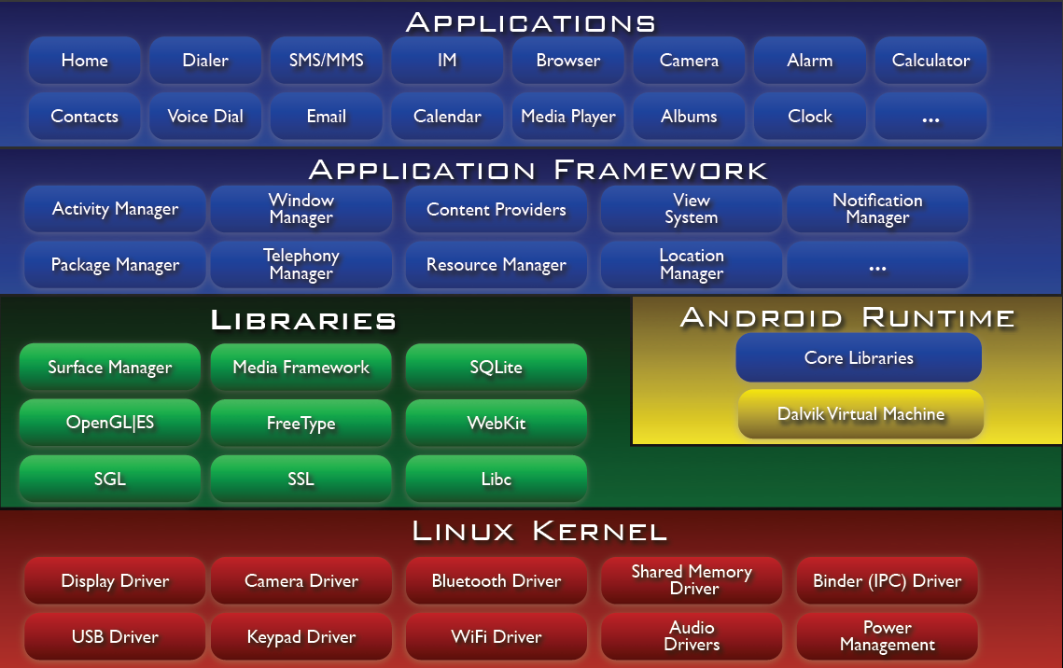
Examples of Systematic Software Reuse
Android is a pattern-oriented software stack for mobile device apps
Java/JNI
C++/C
C
developer.android.com/guide/basics/what-is-android.html

Slide 46
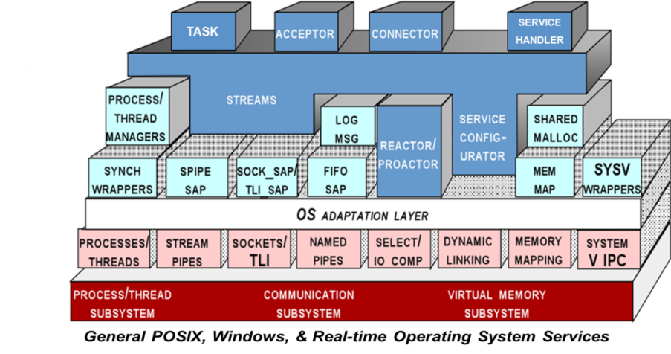
Examples of Systematic Software Reuse
www.dre.vanderbilt.edu/ACE
ACE is a pattern-oriented toolkit containing portable components & frameworks for concurrent & networked software

Slide 47
Examples of Systematic Software Reuse
www.dre.vanderbilt.edu/TAO
www.dre.vanderbilt.edu/ACE
The ACE ORB (TAO) is a pattern-oriented real-time object-request broker

Slide 48
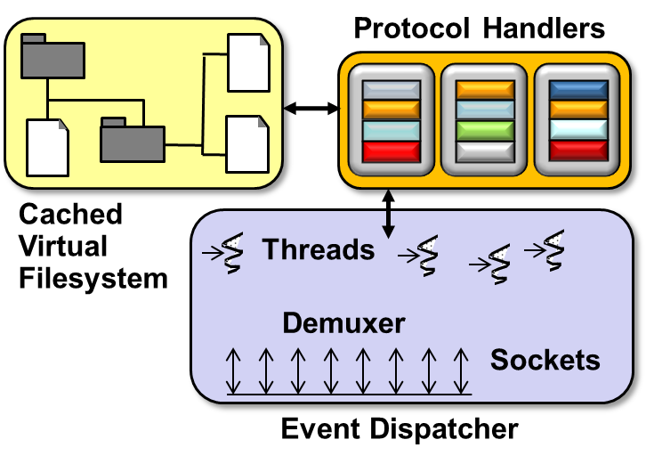
Examples of Systematic Software Reuse
www.dre.vanderbilt.edu/TAO
www.dre.vanderbilt.edu/JAWS
www.dre.vanderbilt.edu/ACE
JAWS is a pattern-oriented high-performance HTTP web server

Slide 49
Examples of Systematic Software Reuse
www.dre.vanderbilt.edu/TAO
www.dre.vanderbilt.edu/JAWS
www.dre.vanderbilt.edu/ACE
Android, ACE, TAO, & JAWS are all freely available in open-source form

Slide 50
Summary
This course will show by example how patterns & frameworks can help to
Codify good software design & implementation practices
Distill & generalize experience
Aid to novices & experts alike

Slide 51
Summary
This course will show by example how patterns & frameworks can help to
Codify good software design & implementation practices
Distill & generalize experience
Aid to novices & experts alike
Give explicit & intuitive names to common design structures
Shared vocabulary
Reduced complexity
Greater expressivity
Subject
Observer
state
observerList
*
update
state = X;
notify();
setData
getData
notify
attach
detach
ConcreteObserver
Observer pattern
update
doSomething
for all observers in observerList do
update()
s->getData()

Slide 52
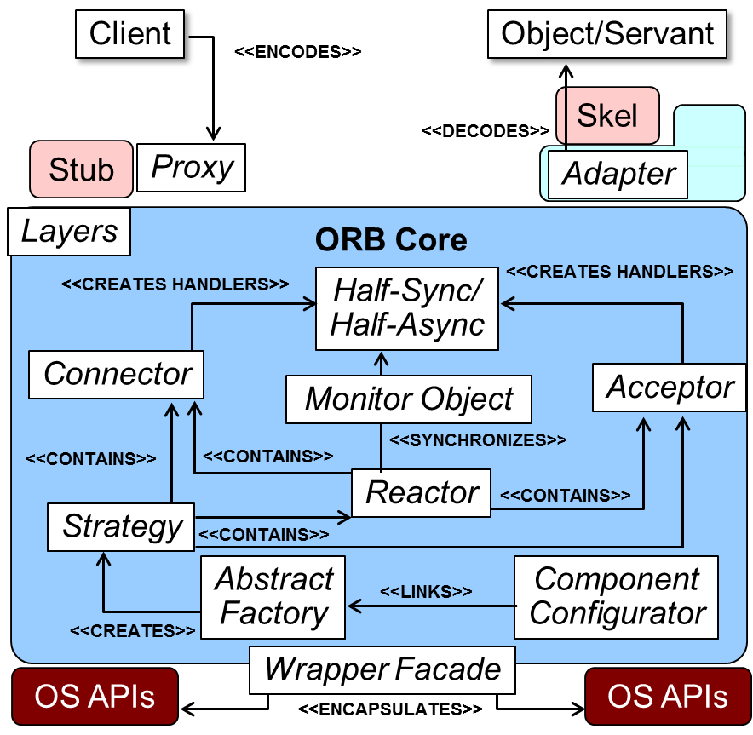
Summary
This course will show by example how patterns & frameworks can help to
Codify good software design & implementation practices
Distill & generalize experience
Aid to novices & experts alike
Give explicit & intuitive names to common design structures
Shared vocabulary
Reduced complexity
Greater expressivity
Capture & preserve design & implementation knowledge
Articulate key decisions succinctly
Improve documentation

Slide 53
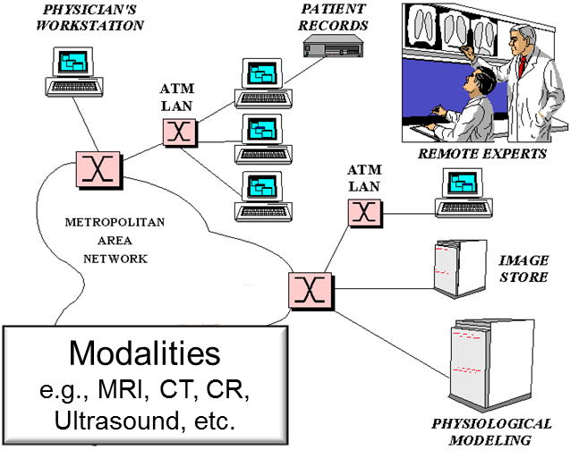
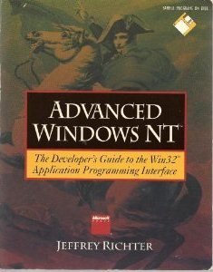
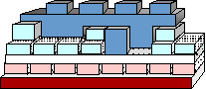
Summary
This course will show by example how patterns & frameworks can help to
Codify good software design & implementation practices
Distill & generalize experience
Aid to novices & experts alike
Give explicit & intuitive names to common design structures
Shared vocabulary
Reduced complexity
Greater expressivity
Capture & preserve design & implementation knowledge
Articulate key decisions succinctly
Improve documentation
Facilitate restructuring/refactoring
Enhance reuse & productivity
Adapt gracefully to the unexpected

Slide 54
Course Overview: Part 3
Douglas C. Schmidt
d.schmidt@vanderbilt.edu
www.dre.vanderbilt.edu/~schmidt
Professor of Computer Science
Institute for Software Integrated Systems Vanderbilt University Nashville, Tennessee, USA

Slide 55


Topics Covered in this Part of the Module
Explore the motivations for & challenges of concurrent & networked software
Describe how patterns & frameworks help address challenges of concurrent & networked software
Outline the course “prerequisities”
Subject
Observer
state
observerList
*
update
state = X;
notify();
setData
getData
notify
attach
detach
ConcreteObserver
update
doSomething
for all observers in observerList do
observer.update()
s->getData()
HTTP Client
GET /index.html HTTP/1.0
HTTP Server
<H1>DOC group page</H1>...
www.dre. vanderbilt.edu

Slide 56
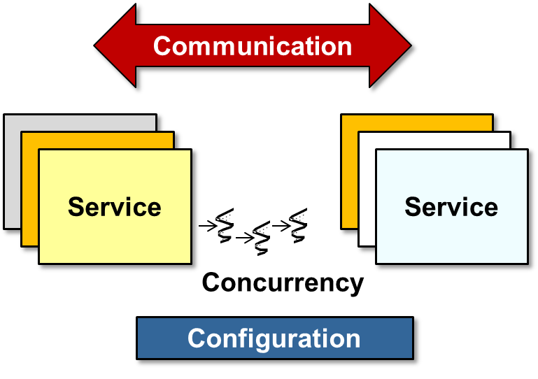
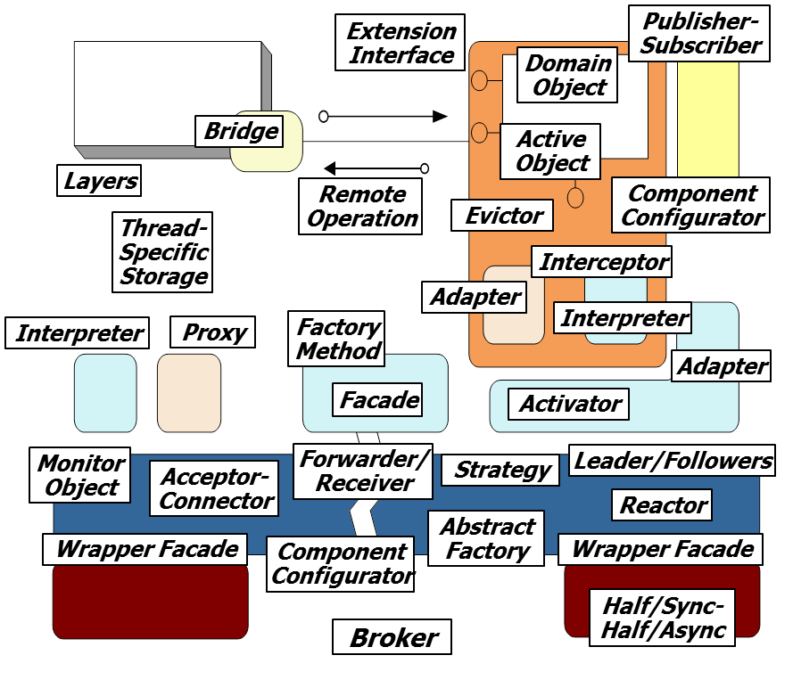
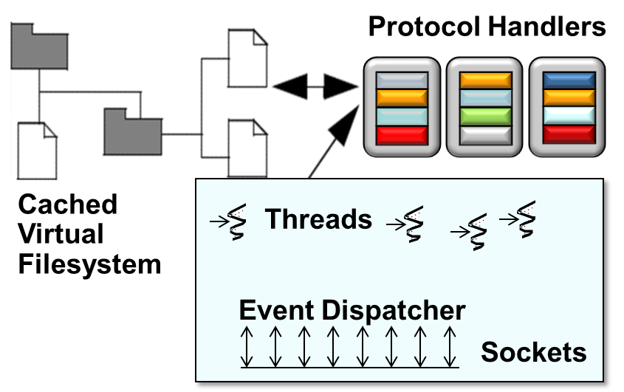
Topics Covered in this Part of the Module
Explore the motivations for & challenges of concurrent & networked software
Describe how patterns & frameworks help address challenges of concurrent & networked software
Outline the course “prerequisities”
Present an overview of the three sections in the course syllabus
Section 1
Section 2
Section 3

Slide 57



Course “Prerequisites”
When I teach courses on patterns & frameworks at Vanderbilt University, I can rely on the students having taken the prerequsities

Slide 58
Course “Prerequisites”
Ideally, you are at least somewhat familiar with
OO programming languages
e.g., classes, inheritance, dynamic binding, & parameterized types available in Java, C++, C#, etc.
template <typename T> class Event_Handler : public Observer<T> { public:
virtual void update
(Observable<T> obs, const T &arg) { /* … */ }
…
template <typename T> class Event_Source : public Observable<T>, public ACE_Task_Base { public:
virtual void svc () { /* … */ notify_observers (/* … */); }
…
Event_Source<Data_Block> event_source;
Event_Handler<Data_Block> event_handler;
event_source->add_observer (event_handler);
Event_Task<Data_Block> task (event_source);
task->activate ();
…
If you don’t know Java or C++ you’ll struggle with later sections of the course

Slide 59

Course “Prerequisites”
Ideally, you are at least somewhat familiar with
OO programming languages
e.g., classes, inheritance, dynamic binding, & parameterized types available in Java, C++, C#, etc.
OO design concepts & notations
e.g., encapsulation, abstraction, polymorphism, extensibility

Slide 60







Course “Prerequisites”
Ideally, you are at least somewhat familiar with
OO programming languages
e.g., classes, inheritance, dynamic binding, & parameterized types available in Java, C++, C#, etc.
OO design concepts & notations
e.g., encapsulation, abstraction, polymorphism, extensibility, & UML
implementation pseudocode
en.wikipedia.org/wiki/Unified_Modeling_Language

Slide 61


Course “Prerequisites”
Ideally, you are at least somewhat familiar with
OO programming languages
e.g., classes, inheritance, dynamic binding, & parameterized types available in Java, C++, C#, etc.
OO design concepts & notations
e.g., encapsulation, abstraction, polymorphism, extensibility, & UML
Systems programming concepts
e.g., event (de)muxing, processes/ threads, synchronization, & inter- process communication (IPC)

Slide 62

Course “Prerequisites”
Ideally, you are at least somewhat familiar with
OO programming languages
e.g., classes, inheritance, dynamic binding, & parameterized types available in Java, C++, C#, etc.
OO design concepts & notations
e.g., encapsulation, abstraction, polymorphism, extensibility, & UML
Systems programming concepts
e.g., event (de)muxing, processes/ threads, synchronization, & inter- process communication (IPC)
Networking concepts
e.g., client/server & peer-to-peer architectures, TCP/IP, & layering
SYN
SYN/ACK
ACK
Host A
Host B
3-way handshake in TCP/IP
HTTP Client
GET /index.html HTTP/1.0
HTTP Server
<H1>DOC group page</H1>...
www.dre. vanderbilt.edu

Slide 63
Course “Prerequisites”
Ideally, you are at least somewhat familiar with
OO programming languages
e.g., classes, inheritance, dynamic binding, & parameterized types available in Java, C++, C#, etc.
OO design concepts & notations
e.g., encapsulation, abstraction, polymorphism, extensibility, & UML
Systems programming concepts
e.g., event (de)muxing, processes/ threads, synchronization, & inter- process communication (IPC)
Networking concepts
e.g., client/server & peer-to-peer architectures, TCP/IP, & layering
SYN
SYN/ACK
ACK
Host A
Host B
3-way handshake in TCP/IP
HTTP Client
GET /index.html HTTP/1.0
HTTP Server
<H1>DOC group page</H1>...
www.dre. vanderbilt.edu
We’ll review key OO design, systems programming, & networking concepts

Slide 64

Course Syllabus
This course is composed of three Sections
Notes:
http://www.flickr.com/photos/41096997@N00/2318060944/

Slide 65
Course Syllabus
This course is composed of three Sections
Each Section is composed of Modules
Notes:
http://www.flickr.com/photos/41096997@N00/2318060944/

Slide 66
Course Syllabus
This course is composed of three Sections
Each Section is composed of Modules
Each Module is composed of Parts
Notes:
http://www.flickr.com/photos/41096997@N00/2318060944/

Slide 67
Course Syllabus
This course is composed of three Sections
Each Section is composed of Modules
Each Module is composed of Parts
Each Part is ~20 minutes long
Notes:
http://www.flickr.com/photos/41096997@N00/2318060944/

Slide 68
Course Syllabus
This course is composed of three Sections
Each Section is composed of Modules
Each Module is composed of Parts
Each Part is ~20 minutes long
Every ~5 minutes there’s a quiz
Notes:
http://www.flickr.com/photos/41096997@N00/2318060944/

Slide 69
Course Syllabus
This course is composed of three Sections
Each Section is composed of Modules
Each Module is composed of Parts
Each Part is ~20 minutes long
Every ~5 minutes there’s a quiz
We’ll have several programming assignments that can be written in C++ or Java
A Statement of Accomplishment requires you to do the quizzes & assignments
Notes:
http://www.flickr.com/photos/41096997@N00/2318060944/

Slide 70
Course Syllabus
Section 1 – Introduction to concurrent & networked software
Layers
Design dimensions
OS programming mechanisms
Android programming mechanisms
This section focuses primarily on concepts – there’s little/no code/patterns here

Slide 71
Course Syllabus
Section 2 – Introduction to patterns & frameworks (with emphasis on concurrent & networked software)
Pattern concepts
Pattern examples
Pattern relationships
Framework concepts
Framework examples
Pros & cons of patterns & frameworks
Reference material
Extension Interface
Publisher- Subscriber
Domain Object
Bridge
Active Object
Layers
Remote Operation
Component Configurator
Thread-Specific Storage
Evictor
Interceptor
Adapter
Interpreter
Proxy
Factory Method
Interpreter
Adapter
Facade
Activator
Monitor Object
Acceptor- Connector
Forwarder/ Receiver
Strategy
Leader/Followers
Reactor
Abstract Factory
Wrapper Facade
Component Configurator
Wrapper Facade
Half/Sync-Half/Async
Broker
This section focuses on design – there’s some Java/C++/C code shown here

Slide 72

Course Syllabus
Section 3 – Applying patterns & frameworks to concurrent & networked software
Service access & configuration
Event handling
Concurrency
Synchronization
Focus is on applying POSA2 & GoF patterns – lots of C++/Java code examples

Slide 73


Course Syllabus
Section 3 – Applying patterns & frameworks to concurrent & networked software
Service access & configuration
Event handling
Concurrency
Synchronization
Protocol Handlers
Cached Virtual Filesystem
Threads
Demuxer
Sockets
Event Dispatcher
Focus is on a framework-based web server using ACE (C++) & Android (Java)

Slide 74



Course Syllabus
Section 3 – Applying patterns & frameworks to concurrent & networked software
Service access & configuration
Event handling
Concurrency
Synchronization
We also cover patterns & frameworks for other domains throughout the course

Slide 75

Summary
Since there’s a lot of material in this course—& you may not be familiar with all the prerequisites—I therefore encourage you to
Watch the videos multiple times

Slide 76

Summary
Since there’s a lot of material in this course—& you may not be familiar with all the prerequisites—I therefore encourage you to
Watch the videos multiple times
Read the various online resources at the provided URLs

Slide 77



Summary
Since there’s a lot of material in this course—& you may not be familiar with all the prerequisites—I therefore encourage you to
Watch the videos multiple times
Read the various online resources at the provided URLs
Read the books that are recommended

Slide 78

Summary
Since there’s a lot of material in this course—& you may not be familiar with all the prerequisites—I therefore encourage you to
Watch the videos multiple times
Read the various online resources at the provided URLs
Read the books that are recommended
Join a “meetup group”
www.meetup.com/Coursera

Slide 79

Summary
Since there’s a lot of material in this course—& you may not be familiar with all the prerequisites—I therefore encourage you to
Watch the videos multiple times
Read the various online resources at the provided URLs
Read the books that are recommended
Join a “meetup group”
Participate in the course online discussion forum
…
…
…
…
…
…
…
…
…
…
…
Notes:
http://www.flickr.com/photos/45409431@N00/4105827270/

Slide 80

Summary
Since there’s a lot of material in this course—& you may not be familiar with all the prerequisites—I therefore encourage you to
Watch the videos multiple times
Read the various online resources at the provided URLs
Read the books that are recommended
Join a “meetup group”
Participate in the course online discussion forum
Apply to Vanderbilt University!
See www.vanderbilt.edu for more info on Vanderbilt University

Slide 81

Summary
Since there’s a lot of material in this course—& you may not be familiar with all the prerequisites—I therefore encourage you to
Watch the videos multiple times
Read the various online resources at the provided URLs
Read the books that are recommended
Join a “meetup group”
Participate in the course online discussion forum
Apply to Vanderbilt University!
See engineering.vanderbilt.edu/eecs for more info on CS program

Slide 82


Summary
Since there’s a lot of material in this course—& you may not be familiar with all the prerequisites—I therefore encourage you to
Watch the videos multiple times
Read the various online resources at the provided URLs
Read the books that are recommended
Join a “meetup group”
Participate in the course online discussion forum
Apply to Vanderbilt University!
See www.isis.vanderbilt.edu for more info on ISIS

